Slide 1
Proof of correctness
The Bellman Ford Algorithm

Slide 2
REview - what does BellMan-Ford do again?
For each node in the graph - 1
For each edge in the graph
If the distance from edge’s start node + length of edge is less than current end node’s distance
Update node distance with new distance
Else:
Leave the distance the same

Slide 3
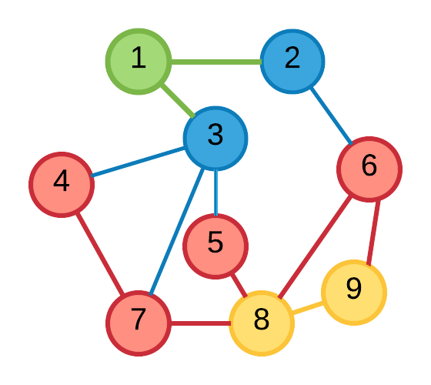
Our Assumption
After the k^{th} iteration, the distance to each node will be the shortest distance path that contains at most k edges.

Slide 4

The Base Case
Initially, all node distances are set to infinity except for the start node that has a distance of 0.

Slide 5
The Base Case
Initially, all node distances are set to infinity except for the start node that has a distance of 0.
As the only path that consists of 0 edges will be from the start node to the start node, this is true.

Slide 6
The K+1th iteration
Before the k+1th iteration, the distance to node U is the smallest length path from S to U containing at most k edges.

Slide 7
The K+1th iteration
During the k+1th iteration, each path from S to U goes through one of the incoming edges (V,U).
As during the k^{th} iteration, the distance to V was the shortest length path containing, at most, k edges...

Slide 8
The K+1th iteration
… the k+1th iteration will only update the distance to U if the length of the path from S to U via V is less than the current distance to U.
This length is at most, k+1 edges long.

Slide 9
Bellman-ford: proof by induction
Relax all edges n - 1 times = the shortest distance (with path length n - 1) from source to every node

Slide 10
Bellman-ford: proof by induction
Relax all edges n times = the shortest distance (with path length n) from source to every node
Let n = 0

Slide 11
Bellman-ford: proof by induction
Relax all edges n times = the shortest distance (with path length n) from source to every node
Let n = 0
No relaxations = shortest distance from source to source (0)

Slide 12
Bellman-ford: proof by induction
Relax all edges n times = the shortest distance (with path length n) from source to every node
Let n = k

Slide 13
Bellman-ford: proof by induction
Relax all edges n times = the shortest distance (with path length n) from source to every node
Let n = k
Relax all edges k times = the shortest distance (with path length k) from source to every node

Slide 14
Bellman-ford: proof by induction
Relax all edges n times = the shortest distance (with path length n) from source to every node
Let n = k + 1

Slide 15
Bellman-ford: proof by induction
Relax all edges n times = the shortest distance (with path length n) from source to every node
Let n = k + 1
Relax all edges k + 1 times

Slide 16
Bellman-ford: proof by induction
Relax all edges n times = the shortest distance (with path length n) from source to every node
Let n = k + 1
Relax all edges k + 1 times
= relax all edges k times + relax all edges 1 time

Slide 17
Bellman-ford: proof by induction
Relax all edges n times = the shortest distance (with path length n) from source to every node
Let n = k + 1
relax all edges k times + relax all edges 1 time

Slide 18
Bellman-ford: proof by induction
Relax all edges n times = the shortest distance (with path length n) from source to every node
Let n = k + 1
relax all edges k times + relax all edges 1 time
By the induction hypothesis

Slide 19
Bellman-ford: proof by induction
Relax all edges n times = the shortest distance (with path length n) from source to every node
Let n = k + 1
relax all edges k times + relax all edges 1 time
= the shortest distance (with path length k) from source to every node + relax all edges 1 time

Slide 20
Bellman-ford: proof by induction
Relax all edges n times = the shortest distance (with path length n) from source to every node
Let n = k + 1
relax all edges k times + relax all edges 1 time
= the shortest distance (with path length k) from source to every node + relax all edges 1 time

Slide 21
Bellman-ford: proof by induction
Relax all edges n times = the shortest distance (with path length n) from source to every node
Let n = k + 1
relax all edges k times + relax all edges 1 time
= the shortest distance (with path length k) from source to every node + relax all edges 1 time
Relaxing an edge will select the shorter path from the source node to the other node, where there is an edge connecting the current path to the other node

Slide 22
Bellman-ford: proof by induction
Relax all edges n times = the shortest distance (with path length n) from source to every node
Let n = k + 1
relax all edges k times + relax all edges 1 time
= the shortest distance (with path length k) from source to every node + relax all edges 1 time
Relaxing ALL edges will ensure that if there is an edge extending the current path to another node, it will be relaxed

Slide 23
Bellman-ford: proof by induction
Relax all edges n times = the shortest distance (with path length n) from source to every node
Let n = k + 1
relax all edges k times + relax all edges 1 time
= the shortest distance (with path length k + 1) from source to every node

Slide 24
Bellman-ford: proof by induction
Relax all edges n times = the shortest distance (with path length n) from source to every node
Let n = k + 1
the shortest distance (with path length k + 1) from source to every node

Slide 25
Bellman-ford: proof by induction
Relax all edges n times = the shortest distance (with path length n) from source to every node
Let n = k + 1
the shortest distance (with path length k + 1) from source to every node
= RHS where n = k + 1

Slide 26
Bellman-ford: proof by induction
Relax all edges n times = the shortest distance (with path length n) from source to every node
Let n = k + 1
the shortest distance (with path length k + 1) from source to every node
= RHS where n = k + 1
Q.E.D.

Slide 27
Algorithm Proved Correct!

Slide 28
